Slide 1
Theory and Practice
of Vaccination
James Truscott

Slide 2
Lecture plan
Review the basic theory of vaccination.
The effect of vaccination on endemic disease in a population.
The effect of vaccination on the disease dynamics.
Rubella vaccination: perverse outcomes.
Vaccination in practice: an example of a successful and an
unsuccessful vaccination implementation.
Pertussis vaccination.

Slide 3
Review of the theory of vaccination
Vaccination is the generation of immunity to a pathogen in an individual through
administering an appropriate immunogen.
To prevent the spread of disease within a population, it’s necessary to vaccinate enough
individuals to achieve herd immunity.
With herd immunity, each infectious individual infects only 1 other, on average.
R₀ is mean number of infections generated by an infectious individual
in a susceptible population.
For vaccination coverage p of the whole population, effective reproductive number:
The minimum vaccination coverage for eradication is

Slide 4
Review of the theory of vaccination
1
persistence
eradication
p_{c} = 1-1/R₀
p_{c}
0
5
10
15
20
R₀

Slide 5
Pre-vaccination R₀ estimates for England and Wales
Infection R₀ p_{c}
Measles 16-18 94-96%
Mumps 11-14 91-93%
Rubella 6-7 83-87%
Pertussis 16-18 94-96%

Slide 6
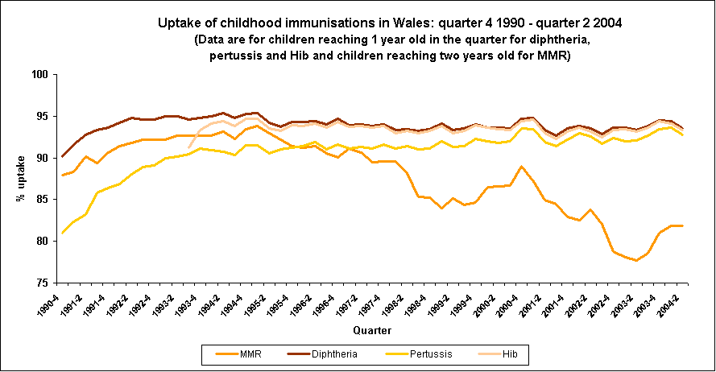
Vaccine coverage in Wales, 1990-2004

Slide 7
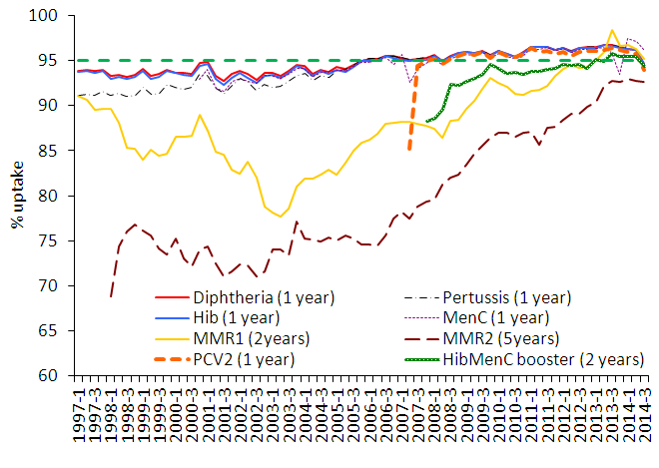
Vaccine coverage in Wales, 1997-2014

Slide 8
Endemic disease in an unvaccinated population
Consider a population in a stable endemic state with a disease that confers lifelong immunity.
Infectious duration, d
Susceptible
Immune
Disease
prevalence
age
Mean
age at
Infection, A
Life
Expectancy,
L
A is closely related to force of infection, the probability per unit time of an individual
becoming infected:

Slide 9
R₀ and the mean age at infection A
Age-serological profiles for Rubella before vaccination
Rubella sero-prevalence by age
A_{UK}= 9-10 yrs
A_{Gambia}= 2-3 yrs
Force of infection = 1/A

Slide 10
Endemic disease in a vaccinated population
Consider same population with a proportion p vaccinated, insufficient for eradication.
It now has average age of infection, A*.
Prop. vaccinated, p
Vaccinated
Susceptible
Immune
A*
L
Proportion of pop^{n} susceptible is now
Comparing to the unvaccinated case:

Slide 11
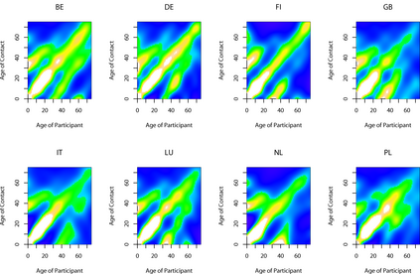
Realistic infectious contacts
Real patterns of contact between individuals are strongly correlated with age.
Figure shows intensity of contact as a function of ages of participants:
Contact strongest between people of similar age.
Contact most intense between school children.
Note contacts between children and parents and also grandparents.
Mossong et al, 2008, PLoS Med., 5, p74

Slide 12
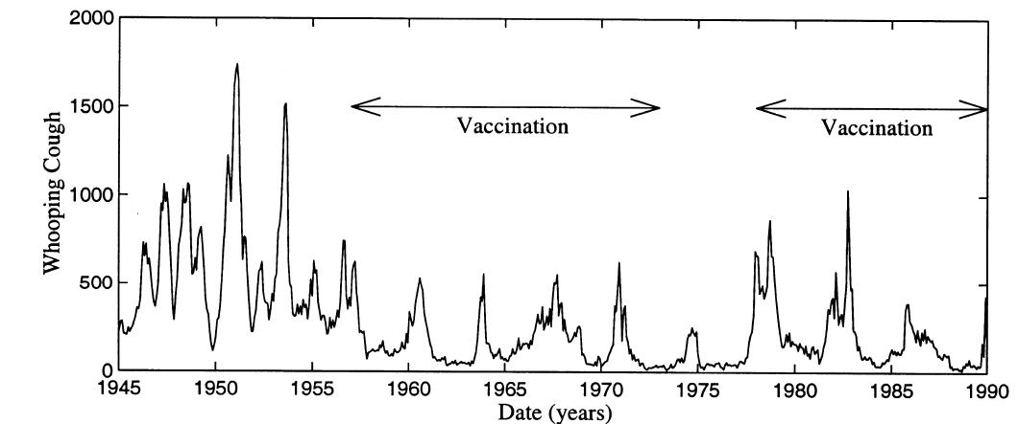
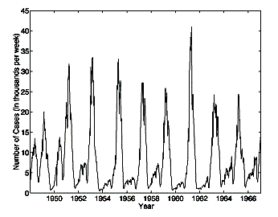
Periodicity in incidence
Infectious diseases are often characterised by periodicity in incidence rates.
The degree of annual variability can be extremely high.
Period can be annual, biannual, three or four yearly or highly variable.
London pertussis notifications
Measles, UK

Slide 13
Seasonality in transmission
Seasonal variation in incidence is mainly generated by annual cycles in transmissibility
between individuals.
School terms
The possible mechanisms of variation are:
Social distance: people spend more time indoors
in winter, increasing the frequency and strength
of contacts.
School terms: Children in school experience more
transmission in school than during holidays.
Absolute humidity: drier air during winter
facilitates aerosol transmission of disease
(influenza).
Vitamin D levels: Lower winter light levels leads
lower Vitamin D levels which increase
susceptibility
Sinusoidal

Slide 14
Effect of vaccination on disease dynamics
The periodicity of disease incidence depends on:
Mean age of infection.
Birth rates in the population
Seasonality of contact rates
with a period approximately given by
The altered mean age of infection under vaccination gives a new longer period:

Slide 15
Simulating the impact of vaccination
Simple SEIR model, modeling 70% vaccination (at birth) with 85% efficacy.
Assume vaccination reduces infectiousness.
Switch from predominantly annual to 4-5 year cycles.
Stochastic model somewhat more realistic.

Slide 16
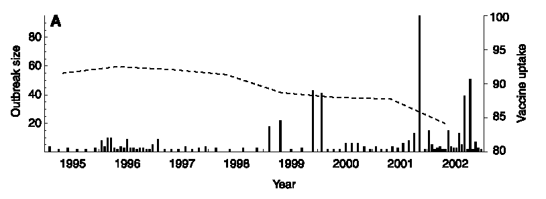
The impact of reduced MMR uptake
The current concern about MMR uptake levels makes predicting the likelihood of a large measles outbreak a priority.
Can data on the current small outbreaks seen in the last few years tell us anything?
[Jansen, V.A.A. et al, Science (2002), 301:804]

Slide 17
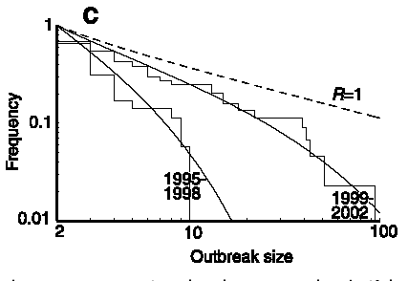
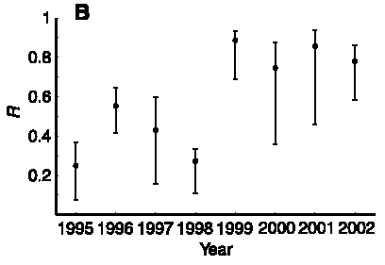
Inferring R from outbreak size distributions
For sub-critical transmission, possible to estimate R from the distribution of outbreak sizes (m=2/(1-R), where m is mean outbreak size).
This analysis shows a significantly increased level of transmission in the period 1999-2002 compared with 1995-98.
R is now dangerously close to 1 – meaning a major measles outbreak is due any time.
This is an intrinsically stochastic analysis – since outbreak size is a random variable.

Slide 18
Introduction to rubella and CRS
Rubella infection
  Virus, directly transmitted
  Mild fever
  Rash (punctate and maculopapular)
  Transmission to foetus possible (p>0.25) when
  acquired during 1st trimester of pregnancy
Congenital rubella infection
  causes Congenital Rubella Syndrome in about 80% of cases
  CRS: deafness, blindness, heart defects

Slide 19
Epidemiology of CRS in the United Kingdom
years | 71-75 | 76-80 | 81-85 | 86-90 | 91-95 | 96-00
CRI only | 40 | 34 | 61 | 25 | 2 | 1
CRS | 201 | 172 | 140 | 88 | 19 | 16
Total CRI/CRS births | 241 | 206 | 201 | 113 | 21 | 17
Terminations for rubella (EW only) | 3709 | 2002 | 759 | 268 | 43 | 17
Vaccination policies in the UK
  1970- 1988: selective immunisation: all schoolgirls, susceptible adult women
  1988- now: MMR in second year of life
  1996: schoolgirl immunisation program ceased

Slide 20
Vaccination: a possible perverse outcome
The existence of an important risk group (women of child-bearing age) outside the usual
age-range of infection can lead to unexpected effects.
Pre-vaccination, most women are already
immune to rubella by child-bearing age.
Introducing vaccination will increase A, and
hence the number of susceptibles in the
risk group, S_{α}.
However, vaccination also decreases the
force of infection, λ_{α}, experienced by the
risk group.
A= 9-10 yrs
Case rate in the risk group is given by S_{α} λ_{α}, so:
If λ_{α} ↓ and S_{α} ↑ then λ_{α} S_{α} ↓ or ↑ ?

Slide 21
Prediction of a simple model
A very simple model, based on vaccination at birth and uniform mixing shows an equilibrium
increase in relative risk for a risk group at age 30. Risk increases with age and R₀.
p_{c}
Is this effect seen in reality and, if so, how should vaccination programs be implemented
to avoid it?

Slide 22
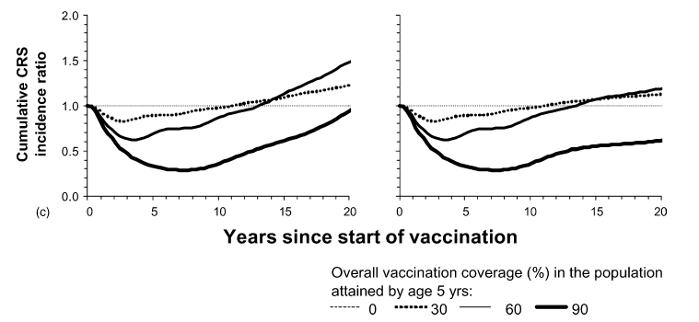
CRS: partially vaccinated populations – short term
MMR is recommended vaccine, but relatively expensive.
In many countries, availability is through private healthcare and hence covers
only a fraction of the population.
Vaccinated group pushes FOI down. What happens to unprotected in
short and long term?
Short term:
Unvaccinated
Whole population

Slide 23
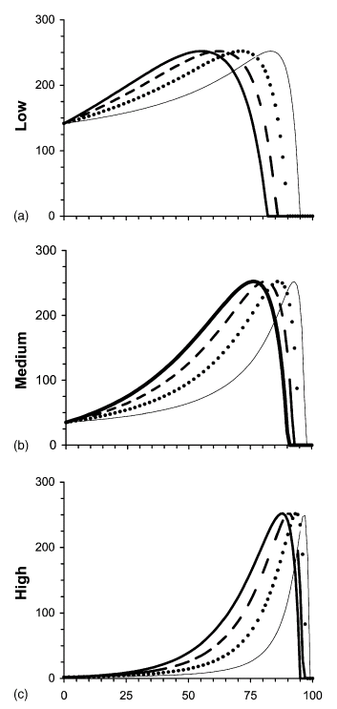
CRS: partially vaccinated populations – long term
Long term effects:
Vaccination always increases CRS incidence in
unvaccinated group.
Incidence increases with coverage, up to a point.
For medium-high pre-vaccination FOI, there is
increase in the population as a whole.
CRS incidence /100,000 births
% coverage

Slide 24
Vaccination in Greece
Rubella vaccination in Greece started in ’77; not compulsory and mainly in private sector.
Aimed primarily at young children (indirect strategy).
Compulsory MMR for 1 year-olds from 1989.
Poor assessment of vaccine uptake and notification of rubella cases. However, coverage
probably <<50% for children up to 1989.
Susceptibility in risk group
Year | % pregnant women susceptible
1971-5 | 12%
1980 | 11%
1981 | 17%
1984-9 | 24%
1990-1 | 36%

Slide 25
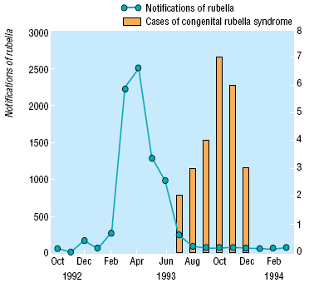
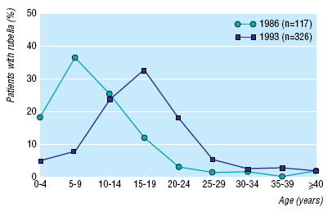
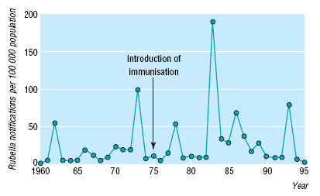
Rubella and CRS in Greece
In 1993, a major rubella epidemic occurred in
Greece, resulting in 25 confirmed CRS cases.
Note shift in age distribution of rubella cases.
CRS incidence matches outbreak, shifted by
7 months.

Slide 26
Implementation of vaccination in Sweden
‘Standard’ vaccination strategy (as used in UK, USA):
1974: direct phase. Vaccination of girls at 12 years. Also women, post-partum,
if susceptible.
1982: indirect phase. vaccination of all 12-year-olds and children at 18 months.
Coverage of target groups approximately 90% and increasing.
Female
Male
Age
Age
12
12
18 months
18 months
1974
1982
1990
1974
1982
1990
Time
Time

Slide 27
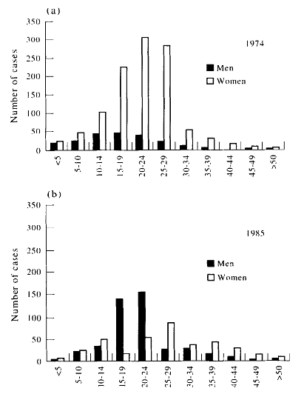
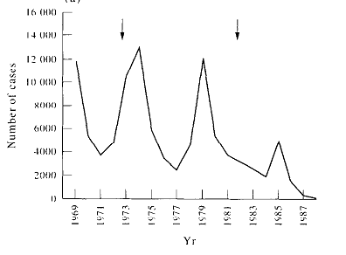
Effect of vaccination in Sweden
Effect of vaccination strategy:
Rubella effectively eradicated since mid-90s.
CRS: since 1973 53 severe cases, since
1985, none.
Pregnant women: 12% susc. -> 3% by ’87.
Changing coverage reflected in gender
distribution of cases.
Note gender-specific reporting bias.
Lab-confirmed cases

Slide 28
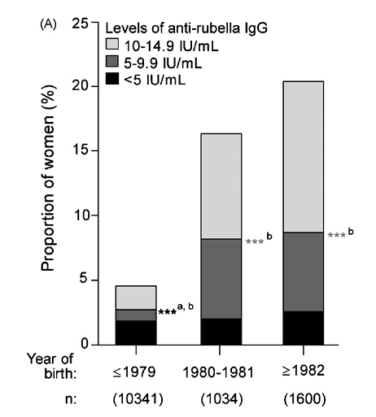
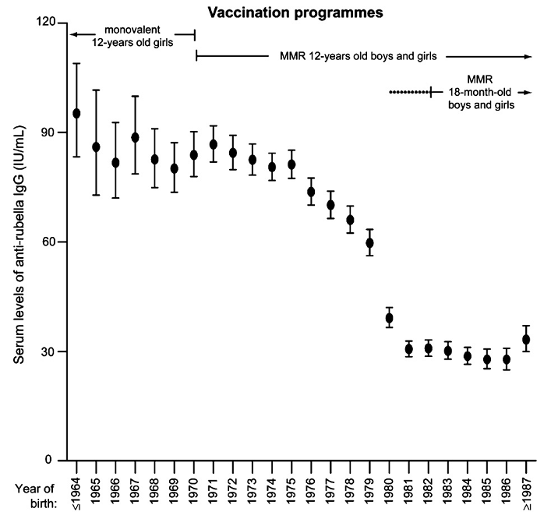
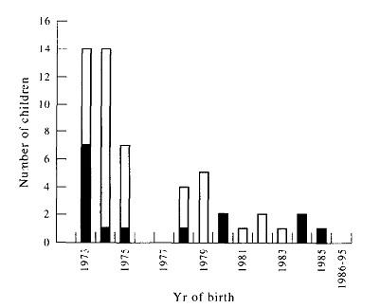
Serology in post-vaccination Sweden
Antenatal sera from primapara women:
95% of pregnant women protected.
Serum IgG levels strongly depend on year of birth.
Weaker protection for those born after ~1980.
‘Natural’ immunity stronger? Frequent challenge?
Possible sub-clinical infections…

Slide 29
Pertussis
Aetiologic agent: Bordetella pertussis, a gram-negative coccobacillus.
Transmission: Highly transmissible (R₀≈16), via direct contact with discharges from respiratory mucous membranes of infected persons.
Clinical Features: Highly communicable, vaccine-preventable disease that lasts for many weeks – can result in very severe coughing, whooping, and post-tussive vomiting.
Major complications: most common in infants and young children and include hypoxia, apnea, pneumonia, seizures, encephalopathy, and malnutrition. High mortality in developing world.

Slide 30
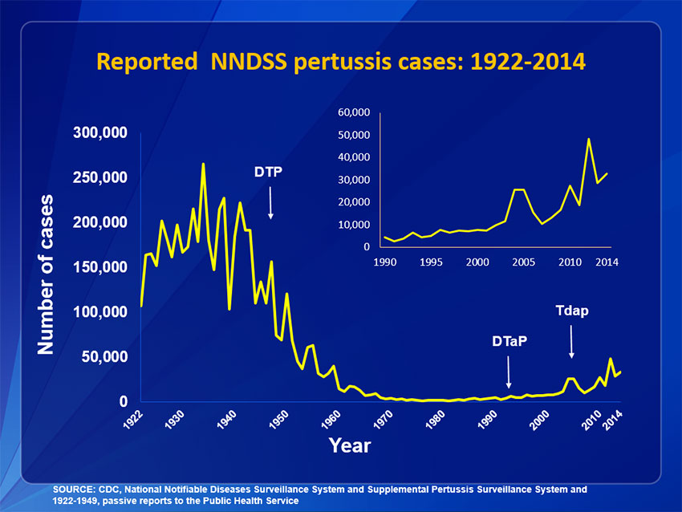
Pertussis incidence trend: US

Slide 31
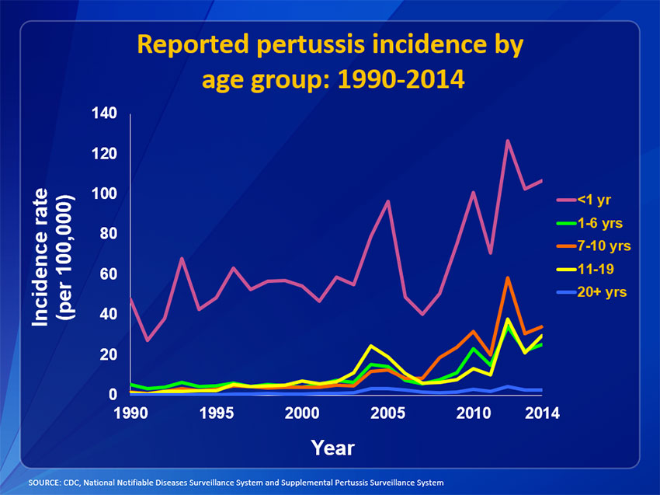
Pertussis incidence trend: by age

Slide 32
Dynamics
Pre-vaccination dynamics show irregular annual epidemic cycles.
Post-vaccination epidemics show ~4 year oscillations.
London pertussis notifications

Slide 33
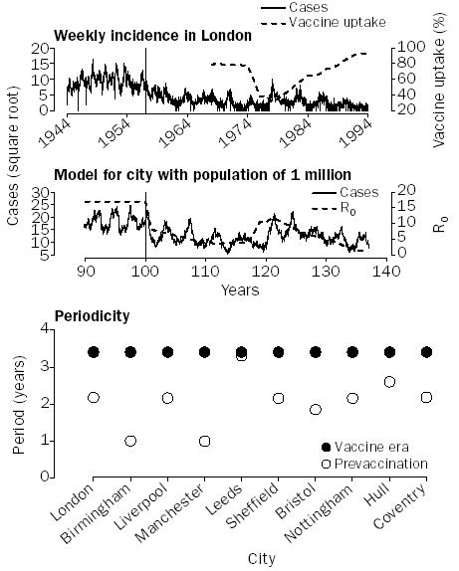
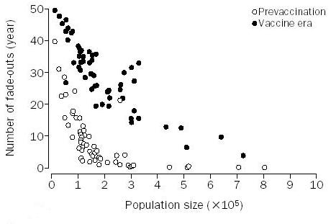
Does vaccination reduce transmission?
Since whole cell vaccine is live, perhaps it contributes to asymptomatic infection?
Can look for signatures of decline in temporal dynamics.
from Rohani et al, Lancet (2000) 355:285-6

Slide 34
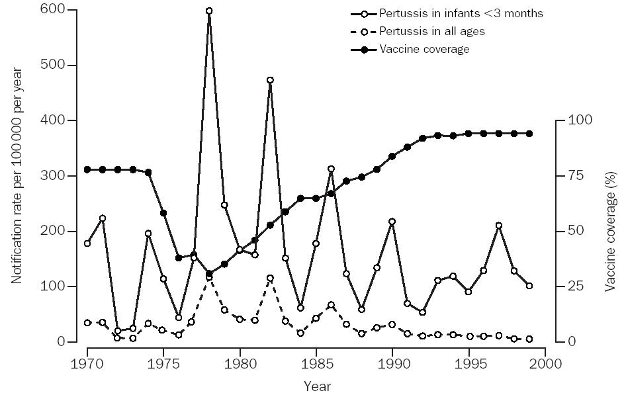
Does vaccination reduce transmission?
Possibly simpler method is to look at age-related patterns of infection.
In particular, look at reported case in infants <3 months (prior to vacc.)
from Gay & Miller, Lancet (2000) 355:1553

Slide 35
Conclusions
Vaccination protects individuals directly, but also indirectly through the effect of
herd immunity.
Vaccination reduces the force of infection in the population and this has indirect
effects on the mean age of infection and the age distribution of sero-positive
individuals.
Vaccination strategies can have unexpected consequences, developing over many
years to produce a negative outcome.
In situations, in which the risk group and population driving the infection differ, great
care is needed in designing vaccine interventions.

Slide 36
References
Kakoulidou, M., Forsgren, M., Lewensohn-Fuchs, I., & Johansen, K. (2009). Serum levels of
rubella-specific antibodies in Swedish women following three decades of vaccination
programmes. Vaccine, 28(4), 1002-1007.
Bottinger, M., & Forsgren, M. (1997). Twenty years’ experience of rubella vaccination in
Sweden: 10 years of selective vaccination (of 12-year-old girls and of women postpartum)
and 13 years of a general two-dose vaccination. Vaccine, 15(14), 1538-1544.
Panagiotopoulos, T. et al., 1999. Increase in congenital rubella occurrence after immunisation
in Greece: retrospective survey and systematic review. BMJ (Clinical research ed.),
319(7223), pp.1462-7.
Vynnycky, E., Gay, N. J., & Cutts, F. (2003). The predicted impact of private sector MMR
vaccination on the burden of Congenital Rubella Syndrome. Vaccine, 21(21-22), 2708-2719.
Rohani, P., Earn, D. J., & Grenfell, B. T. (2000). Impact of immunisation on pertussis
transmission in England and Wales. Lancet, 355(9200), 285-6.
A good mathematical but also practical approach can be found in the early chapters of
Infectious Diseases of Humans: Dynamics and Control. by Anderson and May.

Slide 37
Unused slides

Slide 38
The effect of vaccination on the age-susceptibility profile: a simple model calculation
In endemic equilibrium, prevalence only changes with age (not with time). Hence, for the susceptible population:
Pre-vaccination:
Post-vaccination:
Vacc.
FOI

Slide 39
Vaccination and age-susceptibility profiles
Pre-vaccination:
Post-vaccination:
Ratio of risk =

Slide 40
Empirical evidence for age heterogeneity
For childhood diseases, studies measuring the force of infection have shown that it is age-dependent
Example of data for l: pertussis in England and Wales
The effects of immunization programmes and other observed patterns cannot be reproduced with models without introducing age heterogeneity

Slide 41
Example: Seroprevalence data by age for Rubella, 1987 (Farrington, 2001)
Results of fitting
Homogeneous mixing:
λ=0.11/yr
Heterogeneous mixing:
0-3 yrs: λ=0.098
3-8 yrs: λ=0.15
8-15 yrs: λ=0.12
15-25 yrs: λ=0.056
25+ yrs: λ=0.033
Steeper curve at younger ages and flatter at older ages reflects the stronger contact
among children at school compared to adults.

Slide 42
Realistic infectious contacts
Real patterns of contact between individuals are strongly correlated with age.
Figure shows intensity of contact as a function of ages of participants:
Contact strongest between people of similar age.
Contact most intense between school children.
Note contacts between children and parents and also grandparents.
Mossong et al, 2008, PLoS Med., 5, p74

Slide 43
Effects of interventions on dynamics
London pertussis notifications
Rubella and CRS in Greece
Dynamics are also affected by our interventions, e.g. vaccination.
These can have unexpected or even negative outcomes.
Understanding the consequences of interventions is essential for effective public health policies.

Slide 44
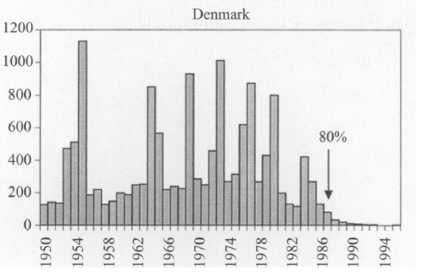
Periodicity in incidence
Measles, UK
Incidence rates are usually highly variable
over time.
A range of periods are observed (annual,
biennial, 3, 4, 5…)
Behaviour often varies over longer time
periods.
Sometimes, behaviour appears random
Mumps, Denmark

Slide 45
Seasonality in transmission
Seasonal variation in incidence is mainly generated by annual cycles in transmissibility
between individuals.
School terms
The possible mechanisms of variation are:
Social distance: people spend more time indoors
in winter, increasing the frequency and strength
of contacts.
School terms: Children in school experience more
transmission in school than during holidays.
Absolute humidity: drier air during winter
facilitates aerosol transmission of disease
(influenza).
Vitamin D levels: Lower winter light levels leads
lower Vitamin D levels which increase
susceptibility
Sinusoidal

